Slide 1

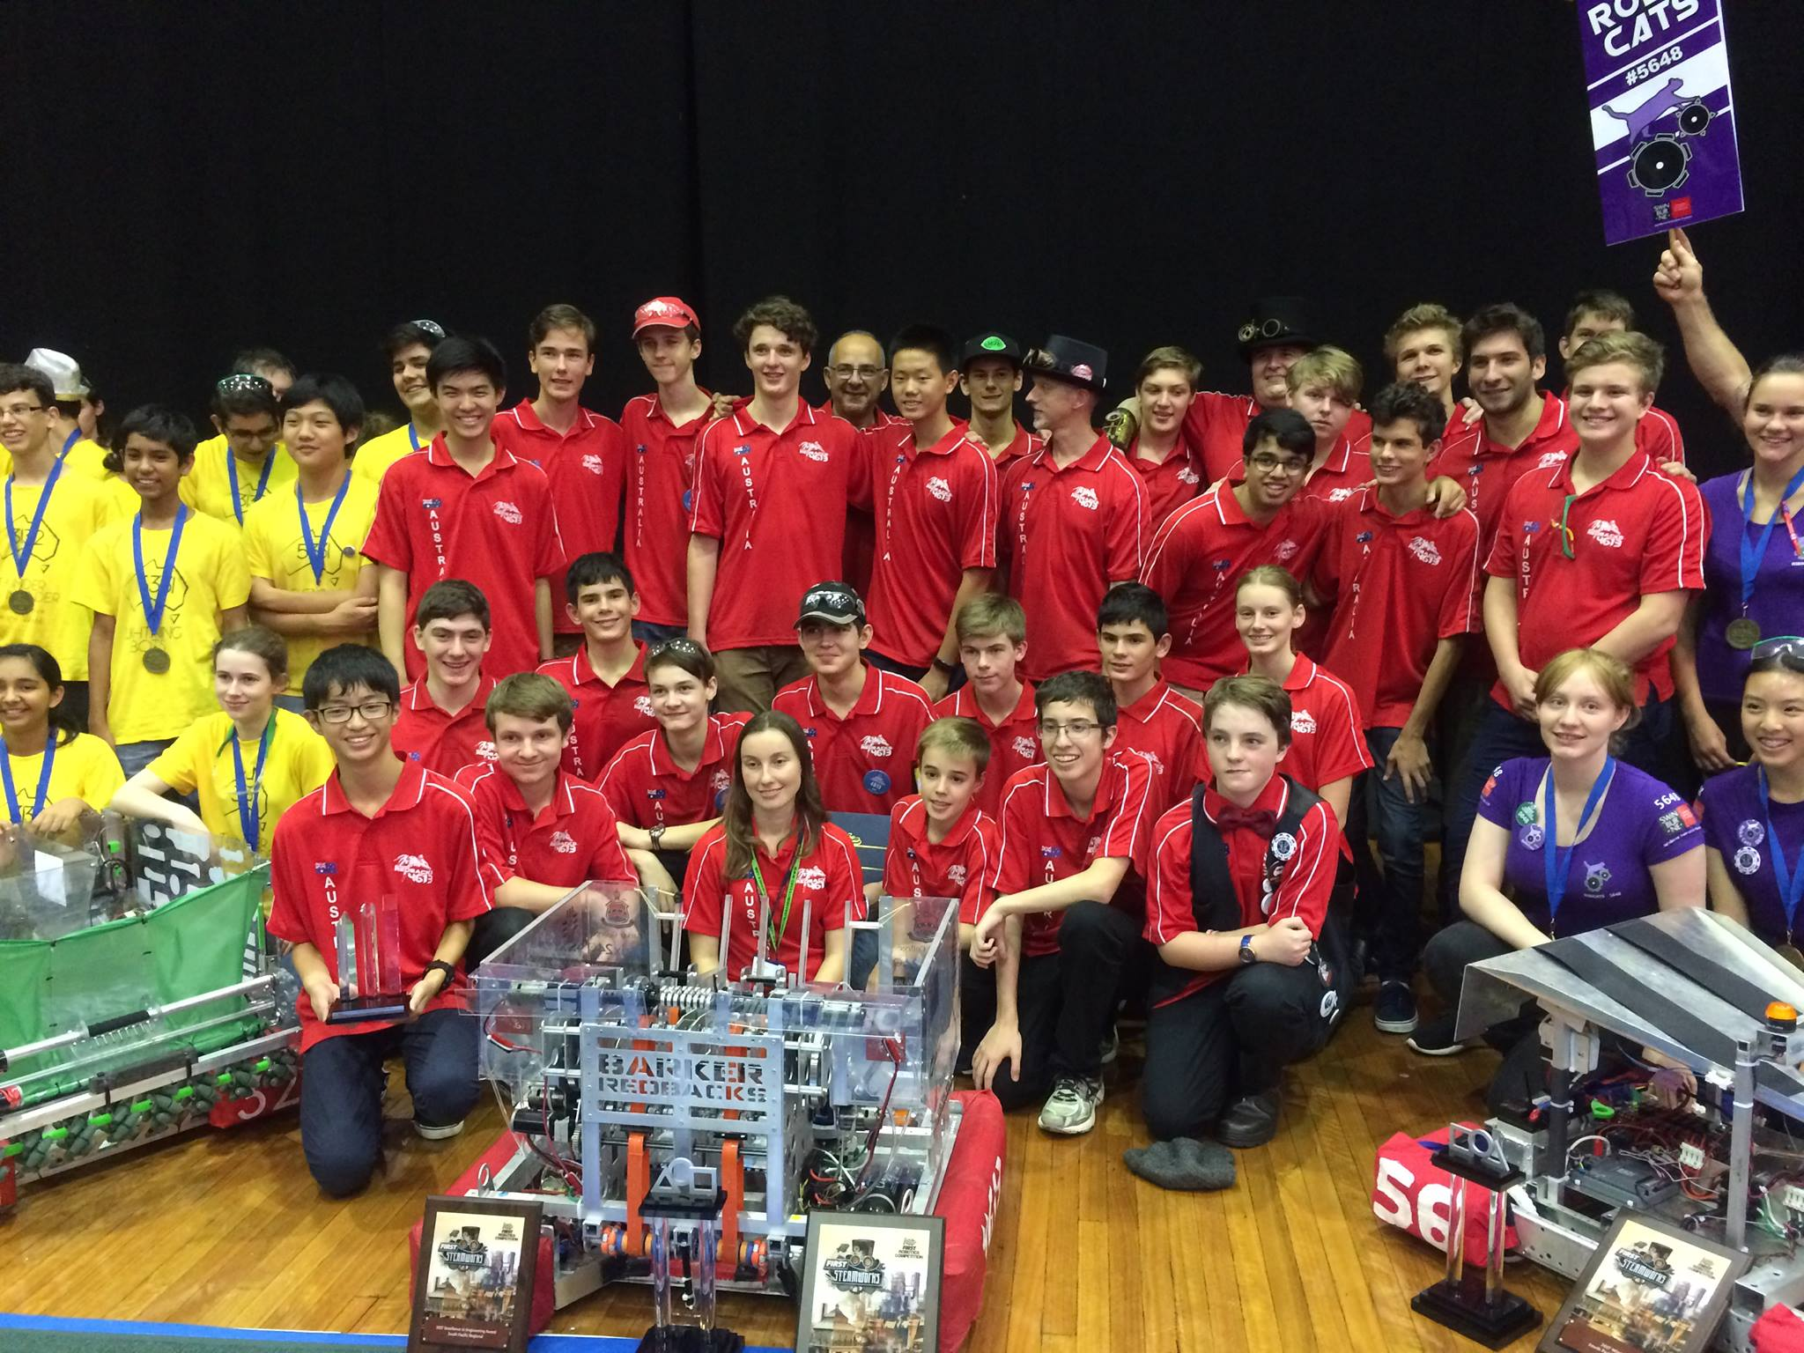
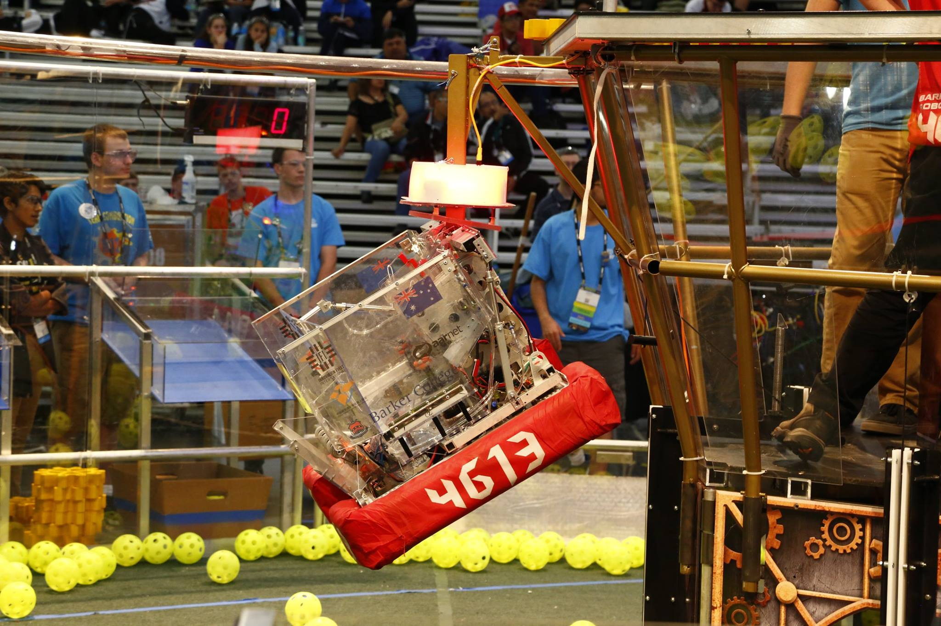
Introduction to (Java) Programming – revision questions
Tom Schwarz

Slide 2
Revision Questions
Write a program to output “Hello World”
Write a program to ask for your name and then greets you, using your name
Modify the previous program so only Alice and Bob get greeted
Write a program to ask for a number x, and then print the sum of numbers 1 to x
Write a program that takes a number, x, and then outputs all prime numbers from 1 to x, using a function to test if the number is prime

